Slide 1

Real-Time Big Data Streaming with Kafka
Notes:
Real-Time Big Data Streaming with Kafka

Slide 2
What is Data Streaming?
Notes:
When we look at the stock market price or the train schedule, or a airport flight information, or anything we see change in real time is data streaming.
Data streaming is the process of continuously transferring and processing large volumes of data in real-time.
It involves sending data from a source to one or more destinations, such as a data warehouse or an application, as a continuous flow of small, incremental updates rather than as a batch of data.
Data streaming technology enables data to be processed in real-time, allowing for faster and more efficient decision-making.
Data streams can come from a variety of sources, including social media platforms, Internet of Things (IoT) devices, financial markets, and website analytics.

Slide 3
Why is Data Streaming important?
Notes:
Data streaming is important for businesses because in a competitive data driven environment, business can:
1. Real-time insights: Businesses can analyze data in real-time providing them the ability to make accurate decisions. For example, your bank texting you about your account.
2. Faster response time: Businesses can respond faster to what ever eventualities providing them with gaining customer confidence.
3. Predictive analytics: With real, time-based data, business can employ algorithms to help them make predictions.
4. Improved efficiency: Businesses gain efficiency by automating repetitive procedures or visibility into their processes and identify bottlenecks, reduce down time and improve overall operational efficiency.

Slide 4
How is Data Streaming done?
Notes:
There are various data streaming technologies available, including Apache Kafka, Apache Spark Streaming, and Apache Flink. These tools provide features such as fault tolerance, scalability, and real-time data processing, making them popular choices for building data-intensive applications.

Slide 5
What is the purpose of this presentation?
Notes:
The purpose of this presentation is to demonstrate live data streaming using Apache Kafka and learn . Apache Kafka is an open-source distributed streaming platform that is used for building real-time data pipelines and streaming applications

Slide 6
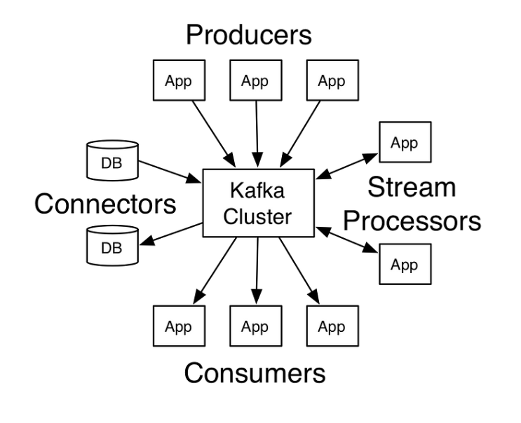
Apache Kafka Architecture
Notes:
The producers are the source of data. It can be an IoT sensor, some files that appear somewhere in the cloud, or data being scraped from a web site(i.e., yFinance provide live and historical stock data). The stream processors and connectors work under the hood. They are responsible for network communication and the processing of streams respectively. Streams are processed in such a fashion as to allow for efficient and reliable transmission of data. The consumers are applications that process the data from producers. As noted, they can perform a wide variety of functions

Slide 7
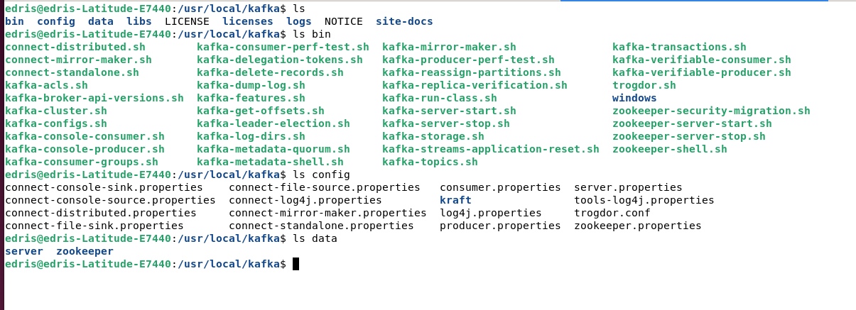
Apache Kafka Environment
Notes:
Apache Kafka runs in Linux environment. It can run in the cloud such as AWS and google cloud. Here, it is running on a local linux server with Ubuntu linux. The bin folder hold the shell scripts to perform various functions The kafka server start and stop as well as zookeeper start, and stop are to start the server and the zookeeper. Other functions such as kafka-topic allow us to create topics, send and receive to/from topic from the command line. We will use python to perform these functions.
The config folder has all the configuration files for servers and background services. The data directory for server and zookeeper contain log files and other related files.

Slide 8

What are Server, Zookeeper and Topics?
Notes:
The Apache Kafka server, which is a part of the Apache Kafka platform, is responsible for managing the distribution and storage of data across the Kafka cluster.
Apache Kafka uses ZooKeeper, a distributed coordination service, to manage the configuration, synchronization, and group membership of Kafka brokers in a cluster.
In Apache Kafka, a topic is a category or feed name to which messages are published. A topic is identified by its name and can be thought of as a logical entity or a message stream.
Messages are sent to a Kafka cluster and are stored in partitions within a topic. Each partition is an ordered, immutable sequence of messages that can be processed independently of other partitions.
Topics are created and managed by the Kafka cluster, and messages can be produced to and consumed from one or more topics by various applications or systems.
Topics can have multiple consumers, and each consumer can read messages from one or more partitions of a topic. Additionally, topics can be replicated across multiple brokers to provide fault tolerance and high availability.
Overall, topics in Kafka provide a way to organize and manage the flow of messages in a distributed system. By using topics, developers can ensure that messages are delivered to the appropriate consumers and that they are processed in the order in which they were received.

Slide 9
Demonstration
Notes:
We are now going to show you a demonstration.
In the next video clip, we will show you the Apach Kafka environment. Show you the python code for two producers and several consumers. One producer sends live, stock data and the other sends flight information read from csv files. The consumer of each display stock data and flight information, respectively.

Slide 10


Slide 11
Applications of a data streaming

Slide 12

Conclusions
Financial Data is everywhere. With computing power of AI/ML, we can use that data to help us make calculated and low risk investment decisions
Notes:
Financial Data is everywhere. With computing power of AI/ML, we can use that data to help us make calculated and low risk investment decisions.

